Slide 1

Cloud Storage
Talha Khalid
OneDrive – Cloud Storage (Training Content)

Slide 2
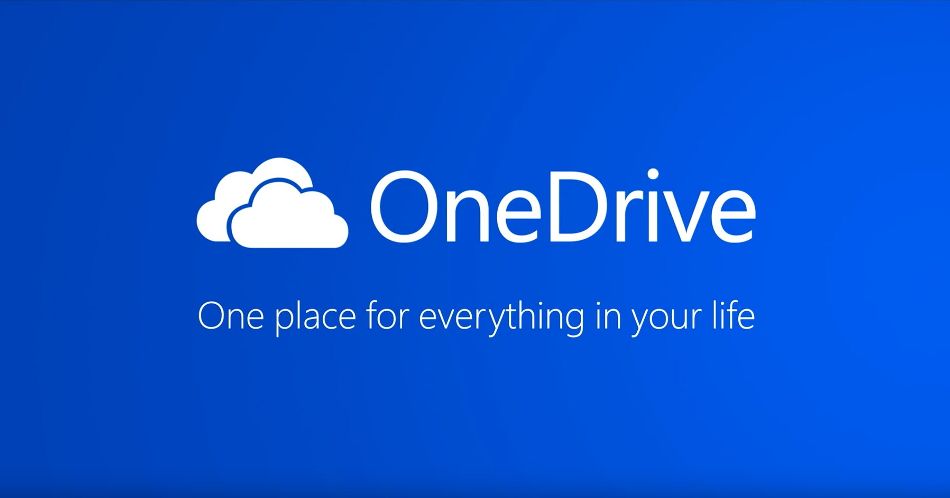
Introduction
Cloud Storage
Cloud storage is online storage provided by company for users to store their data and access it with from anywhere in the world with internet access.

Slide 3
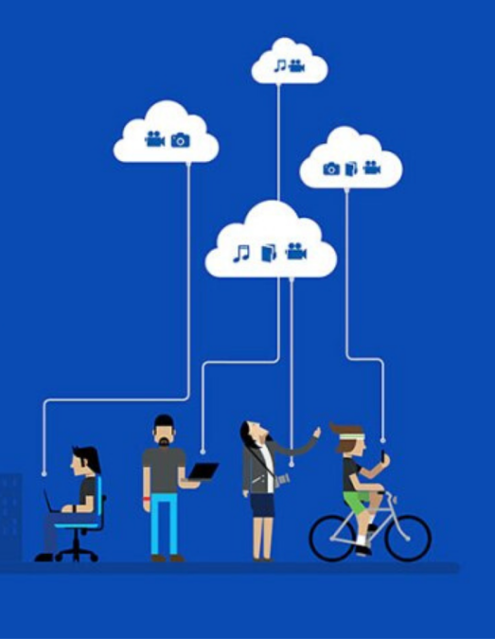
24/7 Available
Features
Provides online storage
Free-up device storage
Shareable folders and files
Secure and 24/7 availability
Top cloud-storage services and their provider.
OneDrive – Microsoft
Google Drive – Google
Dropbox – Dropbox, Inc

Slide 4
SLIDE 2
OneDrive Introduction
IntroDuction.mp4

Slide 5
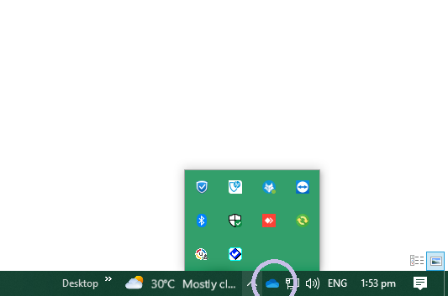
SLIDE 3
OneDrive PC or Laptop Setup
OneDrive PC setup.mp4
Where to find OneDrive icon in windows.

Slide 6
OneDrive android setup
SLIDE 4
Select your Mobile phone.
Android
iPhone
Android setup.mp4
OneDrive Iphone setup
Iphone Setup.mp4

Slide 7
SLIDE 5
OneDrive Basic use (Online - Web)
basic.mp4

Slide 8
SLIDE 6
OneDrive Basic use (App)
App basic.mp4

Slide 9
SLIDE 7
OneDrive files sharing with in ENGRO
Files share.mp4

Slide 10
SLIDE 8
Keep files offline available or free up space to remove them.
Keep file offline.mp4
Note: Don’t always keep files offline while working on shared devices

Slide 11
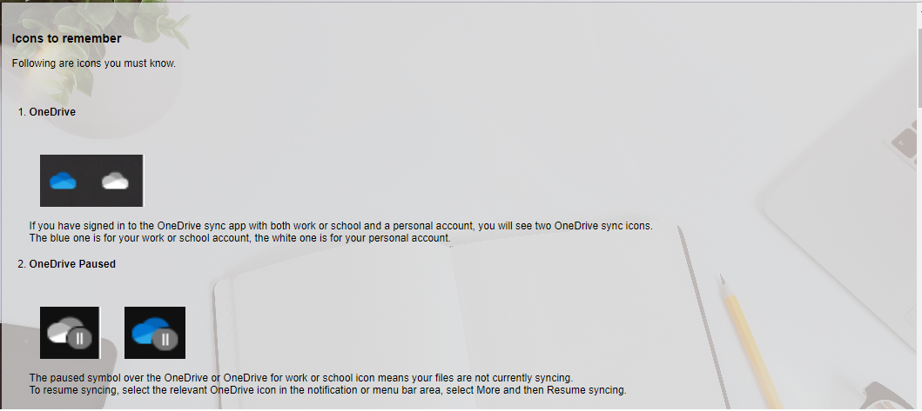

Slide 12
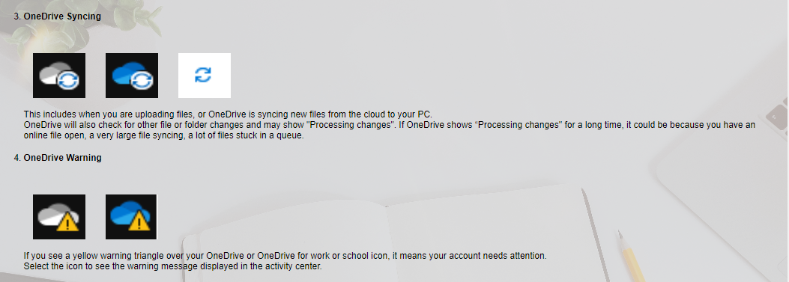

Slide 13
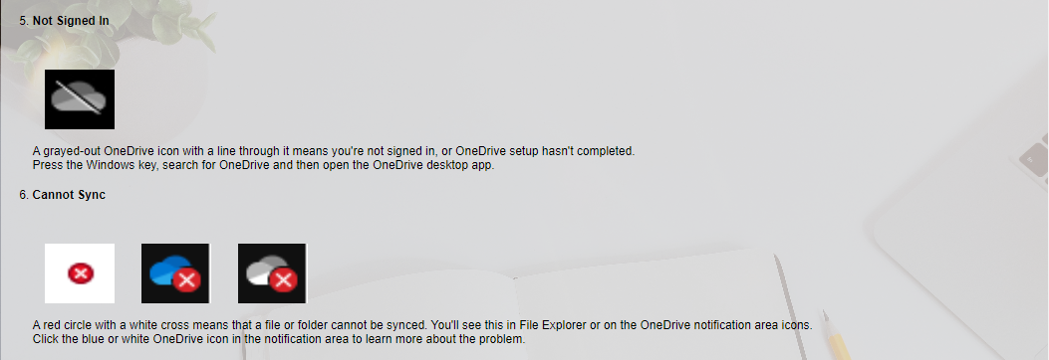

Slide 14
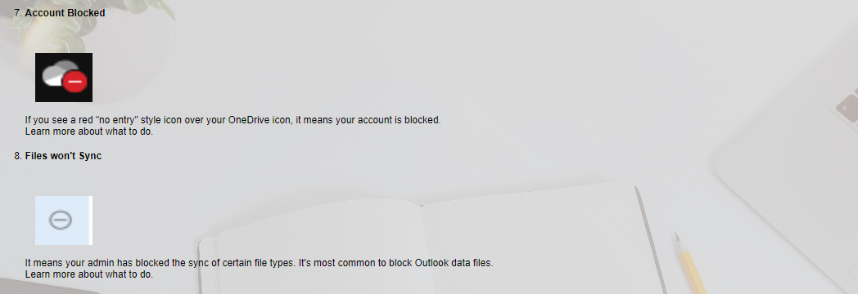

Slide 15
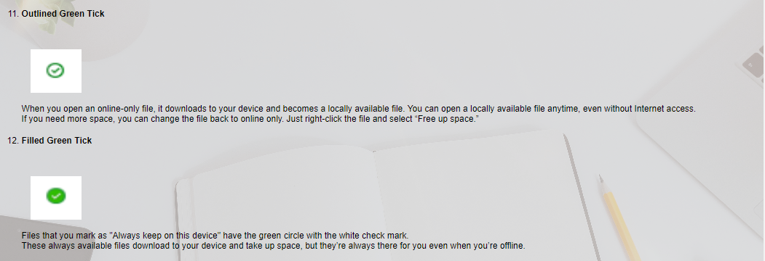

Slide 16
